Slide 1
Predicting Box Office Gross
Sayantan Chattopadhyay

Slide 2
Overview
Data wrangling
Exploratory data analysis
Predictive Modeling

Slide 3
The film is not a success until it makes money. It's only good when there's a dollar figure attached to the box office.
-John Cusack

Slide 4
1. Data Wrangling

Slide 5


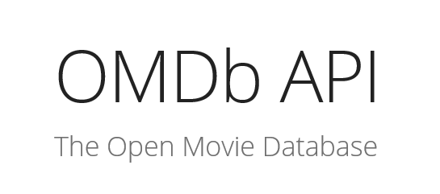
Sources

Slide 6
Data Flow
The Movie Database (TMDB)
OMDB API
Box Office Mojo Data

Slide 7
45,464 Films 12,047 Domestic Grosses 11,022 Opening Weekends 45,368 IMDB Ratings 19730 Rotten Tomatoes Scores 11890 Metascore Ratings
Movie Dataset

Slide 8
2. Exploratory Data Analysis

Slide 9
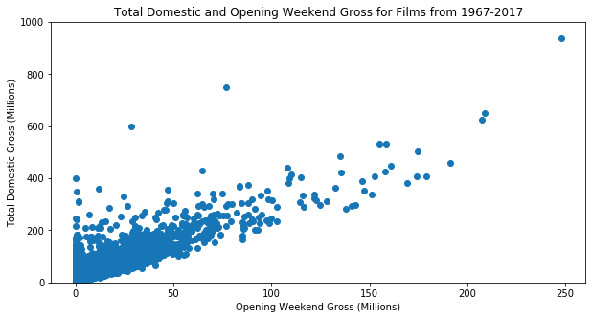
Visualizations

Slide 10
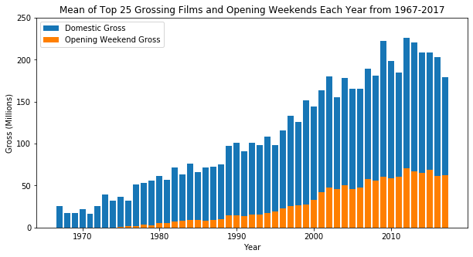

Slide 11
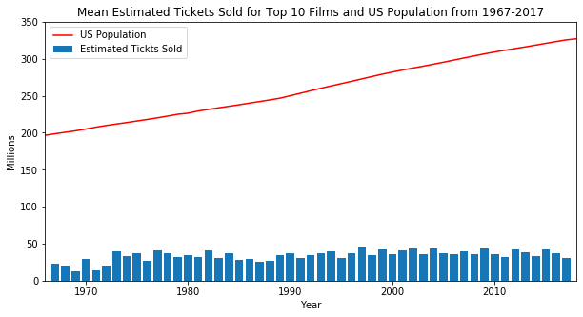

Slide 12
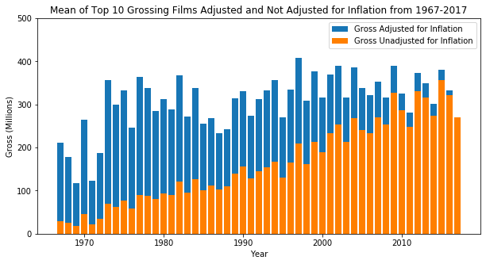

Slide 13
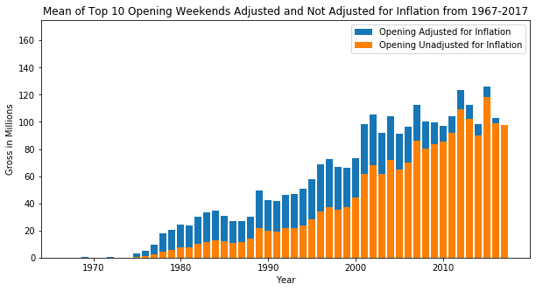

Slide 14
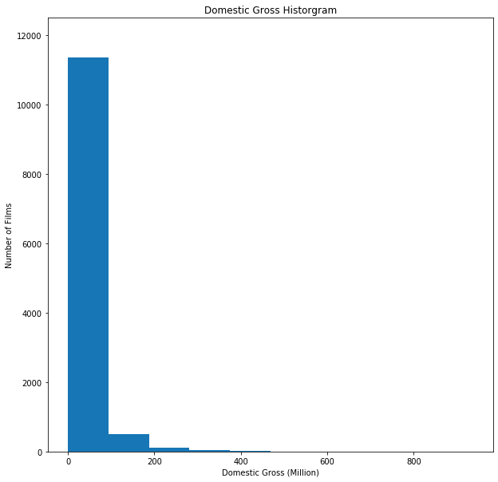
Statistical Analysis

Slide 15
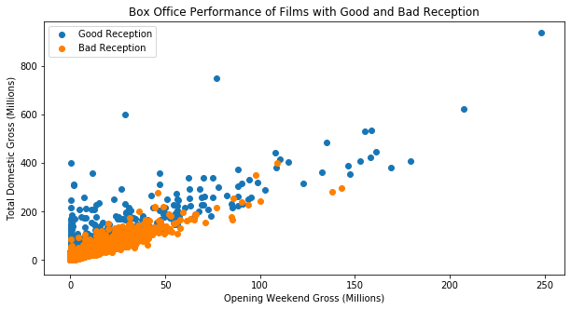

Slide 17
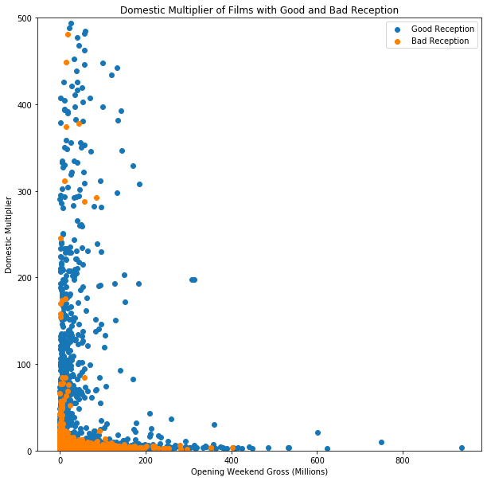

Slide 18
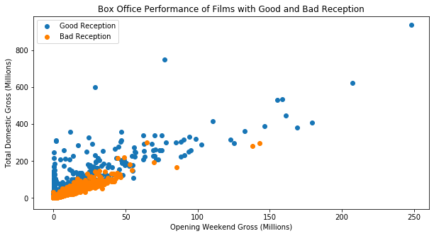

Slide 19
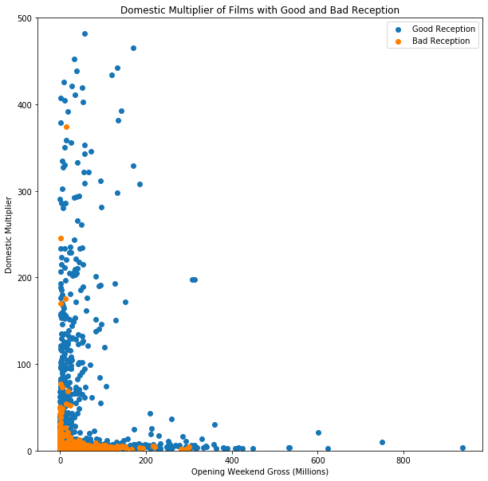

Slide 20
3. Predictive Modeling

Slide 21
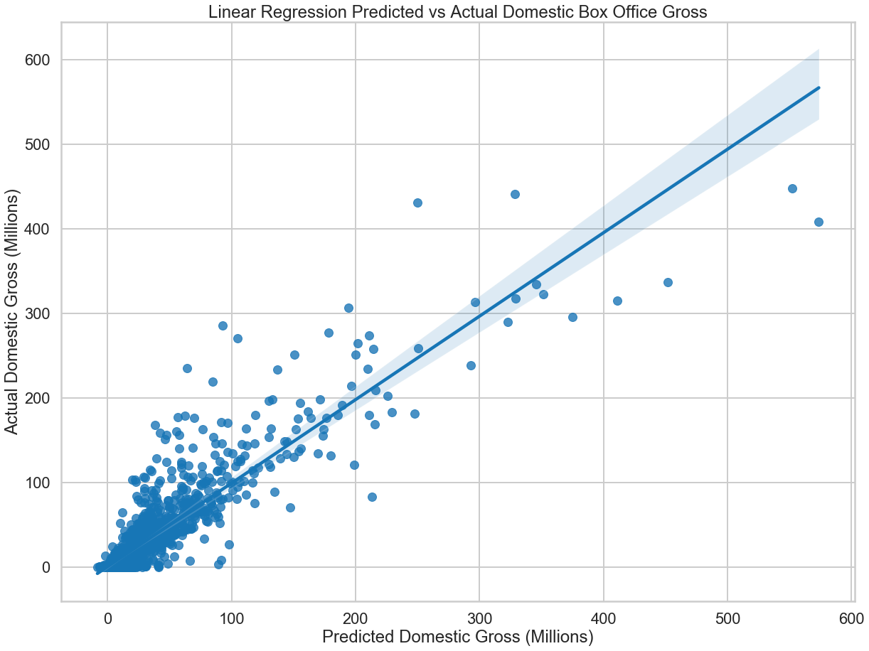
Linear Regression Model

Slide 22
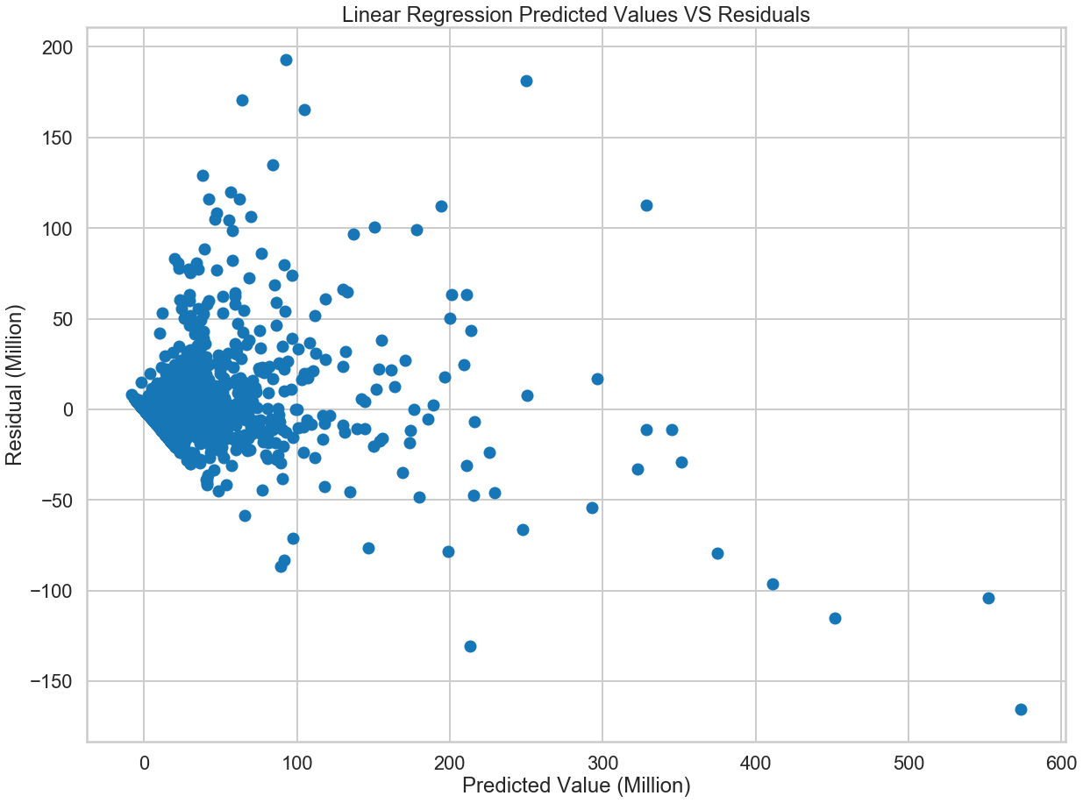

Slide 23
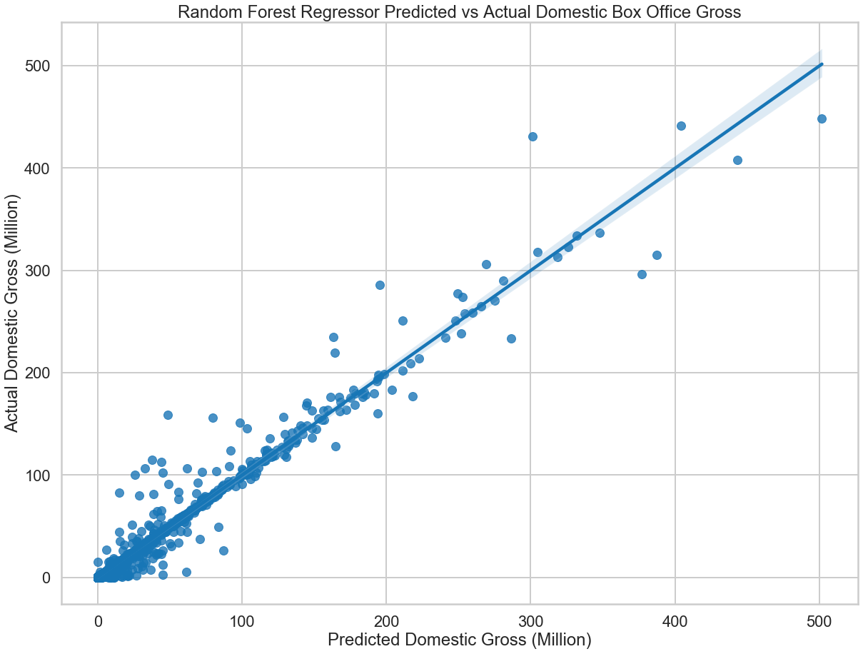
Random Forest
Regression
Model

Slide 24
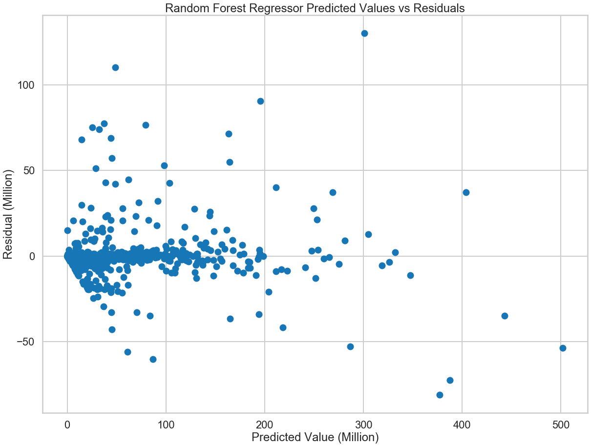

Slide 25
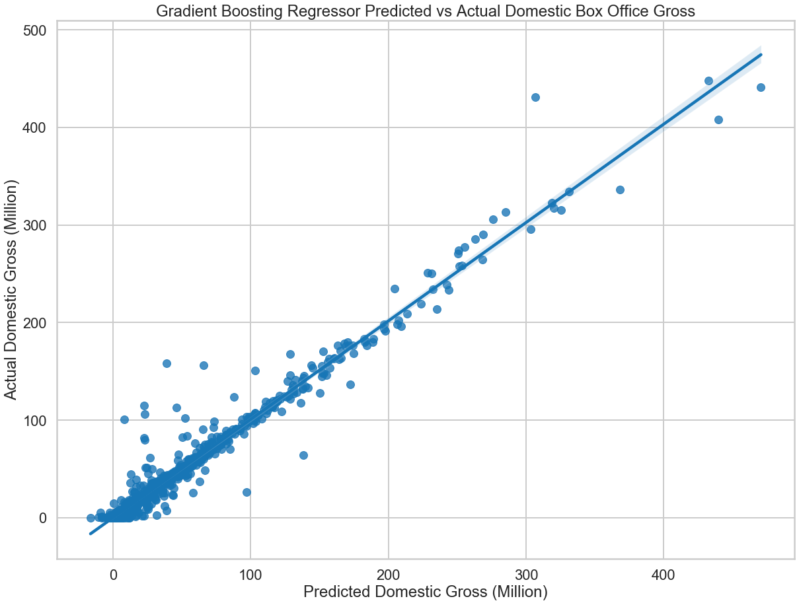
Gradient Boosting Regression
Model

Slide 26
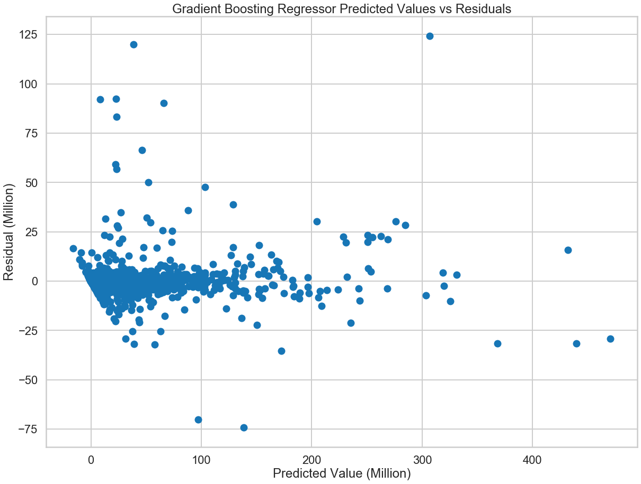

Slide 27
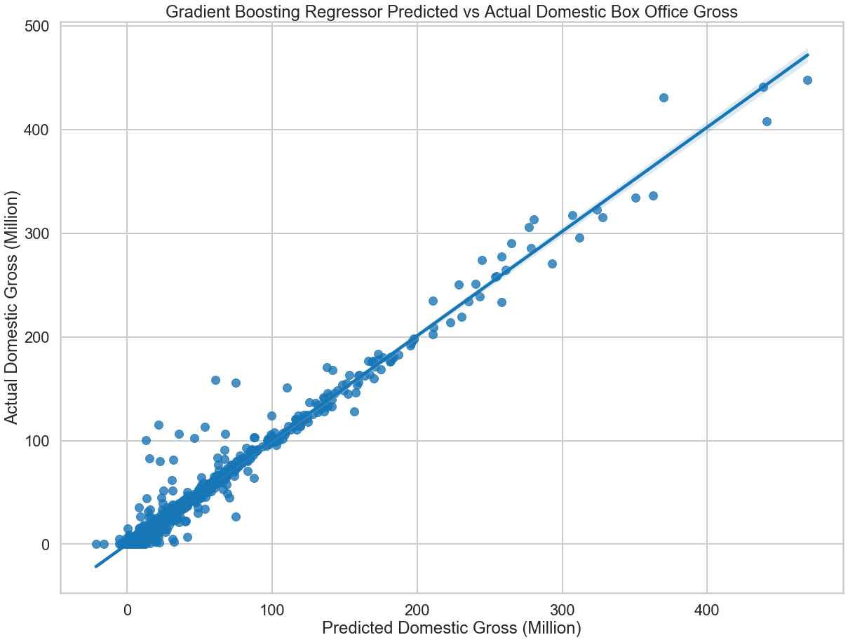
Optimized
Gradient Boosting
Regression Model

Slide 28
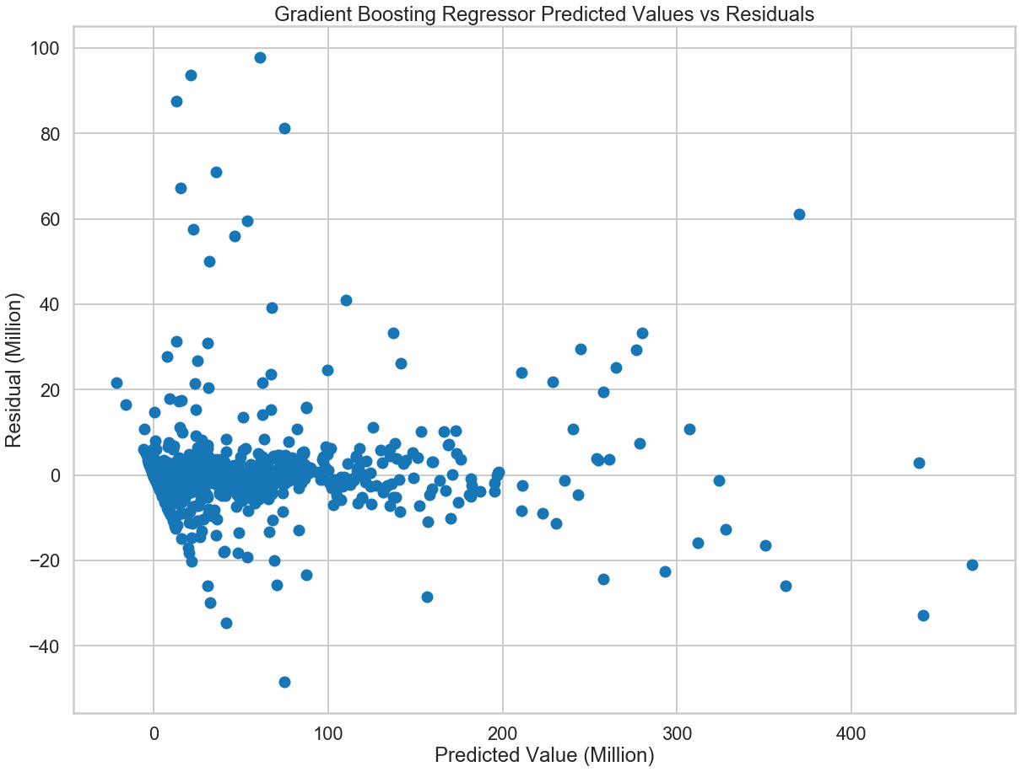

Slide 29
0.9785 R² Value 21.08 M Mean Test Value 2.10 M Mean Absolute Error 6.59 M Root Mean Squared Error 0.9379 5-Fold Cross Validation Score
Results

Slide 30
Conclusion
Using the gradient boosting regressor algorithm provided best results
Results were optimized using hyperparameter tuning
Predictive Model performs particularly well on grosses above 100 million dollars
In future a neural network could be implemented to provide a better predictive model with even greater accuracy

